Slide 1

SP500 INDEX: ANALYSIS AND RELATIONSHIP WITH CORONAVIRUS Group 003-001 Ricardo Calleja Jose Toro Patricio Ramirez Cristian Salinas
St. Clair College Fall 2022

Slide 2
CONTENTS
Backgrond / Motivation.
Problem statement.
Problem proposal.
Analysis questions.
Dataset description.
Steps we expect to perform on our datase.

Slide 3

01.
Background / Motivation.

Slide 4

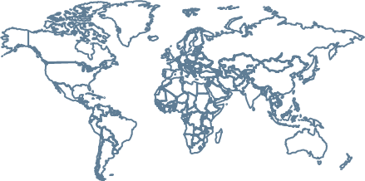
Background / Motivation.
Pandemics are recurrent (Ex. Ebola 2013, Spanish flu 1918 ), and they had an economic impact. The raise of economic uncertainty during Covid-19 pandemic (1), increased investment risk. Understanding the trend of economic actors, could be used as a comparison for similar events in the future.
Regina Ortmann, (2020): “COVID-19 and investor behavior”. https://www.sciencedirect.com/science/article/pii/S1544612320307959

Slide 5
02.
Problem Statement.

Slide 6

”
Investors need to understand the trends of economic factors, during pandemics, in order to use it as a point of comparison for similar events in the future.

Slide 7
03.
Problem proposal

Slide 8

Problem proposal
Create a descriptive analysis to comprehend the behavior of the companies that belongs to SP500 index before (January-March 2019), during (January-March 2020) and after (January-March 2021) COVID-19 outbreak.

Slide 9
04.
Analysis Questions

Slide 10

1) How each economic sector performed in financial terms during the pandemic? 2) How each company performed in financial terms during the pandemic? 3) Which company had the best performance by market capitalization variation?

Slide 11
05.
Dataset Description

Slide 12
Dataset Description
1) The dataset to be used comes from Yahoo Finance API and it includes stock price, share quantity and a description of each company within the SP500.
2) It covers 3 periods (January-March for the year 2019, 2020 and 2021)

Slide 13
06.
Steps we expect to perform on our dataset

Slide 14

Steps we expect to perform on our dataset
Merge Dataset
Consolidate the datasets: S&P500 companies, Shares S&P 500, Average stock price per trimester (2019,2020,2021)
Clean Database
Clean the data that can generate negative effects on the final result
Clean Database
Analyze the data before coming to any assumption
Visualizations
1
2
3
4
Find any NA (if there exist).
Identify outliers.
Identify irregularities.
Describe the data.
Understand the dataset.
Identify segments or groups.
Identify head and tail.
Generate preliminary visualizations.
Explain how was the data collected
Show the information in a comprehensive way

Slide 15
07.
Exploratory Data Analysis (EDA

Slide 16
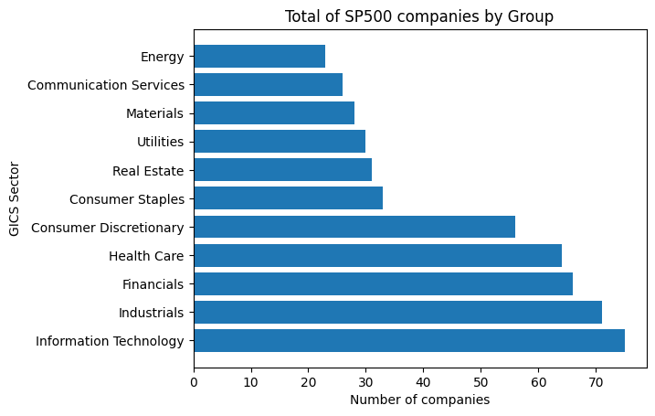
EDA
SP500 index is composed by 503 companies, divided on 11 Sectors, Lead by Information Technology, Industrials and Financial companies.

Slide 17
Data Cleaning/Transformation

Slide 18
EDA

